Slide 1
NAME: Syam Sundar. M REGISTER NUMBER: 312207648 DEPARTMENT: B.COM(General) COLLEGE: Pachaiyappas college Chennai

Slide 2
POPULATION GROWTH

Slide 3
AGENDA:
World population distribution
Factors of population distribution
Definition of population
Factors affecting human population size
Causes of population growth
Projected population growth in major nations
World population growth rate
Evolution of life histories
Conclusion

Slide 4

WORLD POPULATION DISTRIBUTION:

Slide 5
FACTORS OF POPULATION DISTRIBUTION:
TOPOGRAPHY
CLIMATE
WATER SUPPLY
RESOURCES
TECHNOLOGY (NOW)

Slide 6
What is population growth?
An increase in the number of people that reside in a country, state, city etc..
The net change in population between two point of time expressed as percentage of population at a given period of time is called growth rate of population.
To determine whether there has been population growth, the following formula is used: (Birth rate + immigration)– (Death rate + emigration).

Slide 7
Factors affecting human population size:
Population change equation:
Population change = (Births + Immigration) – (Deaths + Emigration).
Crude birth rate = births per 1000 people in population per year.
Crude death rate = deaths per 1000 people in population per year.
Migration= movement of persons from one settlement place to another region for considerable time period.

Slide 8
Causes of population growth:
Near universal incidence of marriage.
Increase in life expectancy.
Better health facilities.
Lack of family planning and birth control awareness in under-develop countries.
Early marriage.
Low infant mortality.
Economic backwardness & illiteracy.
Climatic factors.
High birth rate & declining death rate.

Slide 9
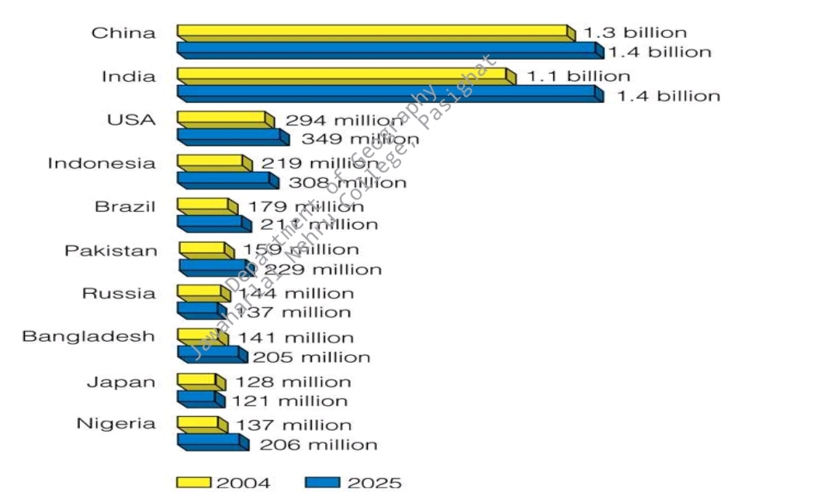
Projected population growth in major nations:

Slide 10
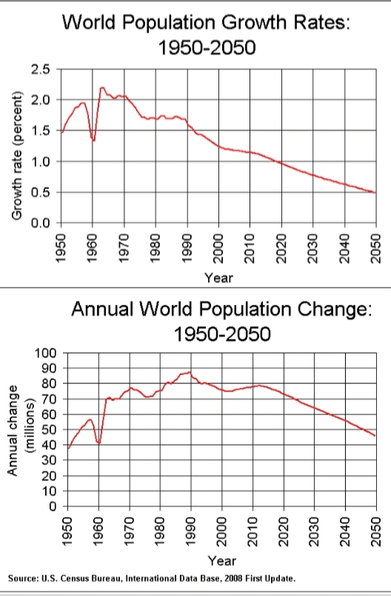
World population growth rate:
The growth rate peaked in 1963 and has been declining since.
Despite the declines in rate, the member of people added to the population each year continued increased until 19990.
Population pyramids helps to explain the difference.

Slide 11
Evolution of life histories:
Life histories features:
Rate of birth, death and population growth.
Patterns of reproduction and portability .
Behaviour associated with reproduction.
Efficiency of resources use and have carrying capacity.
• Anything that affects population growth.

Slide 12
Conclusion:
Overpopulation may lead to many issues like depletion of natural resources, environmental pollution and degradation and loss of surroundings. All countries must take immediate steps to control and manage human population growth.
To mitigate the impact of population growth, international policy focuses on the Sustainable Development Goals, which aim to improve global living standards while reducing society’s impact on the environment.
Increased access to reproductive health care services, including family planning, can also help reduce fertility and accelerate development.

Slide 13
Thank you!!

